Slide 1



Noida Institute of Engineering and Technology, Greater Noida
Optical Filters
Lecture
Unit: III
Physics
Dr. Rajesh Kumar
Department of Physics
Course Details ( B Tech 1st Year. )

Slide 2
Today’s Lecture
Optical Filters

Slide 3
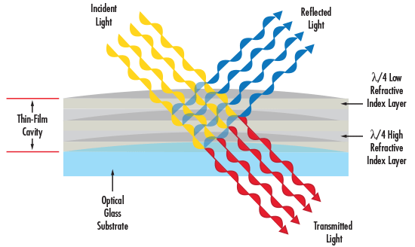
Optical filters
Optical filters are passive devices that allow the transmission of a specific wavelength or set of wavelengths of light. There are two classes of optical filters that have different mechanisms of operation: absorptive filters and dichroic filters.

Slide 4
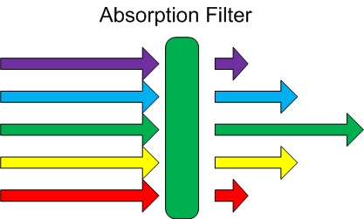
Absorptive Filters
Absorptive filters have a coating of different organic and inorganic materials that absorb certain wavelengths of light, thus allowing the desired wavelengths to pass through. Since they absorb light energy, the temperature of these filters increases during operation. They are simple filters and can be added to plastics to make less costly filters than their glass-based counterparts. The operation of these filters does not depend on the angle of the incident light but on the properties of the material that makes up the filters. As a result, they are good filters to use when reflected light of the unwanted wavelength can cause noise in optical signal.

Slide 5
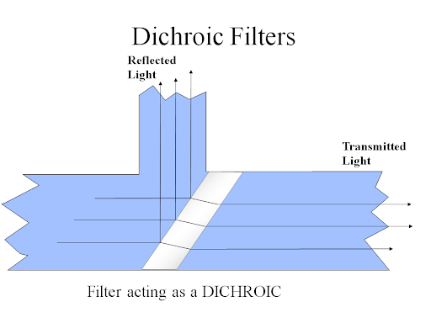
Dichroic Filters
Dichroic filters are more complicated in their operation. They consist of a series of optical coatings with precise thicknesses that are designed to reflect unwanted wavelengths and transmit the desired wavelength range. This is achieved by causing the desired wavelengths to interfere constructively on the transmission side of the filter, while other wavelengths interfere constructively on the reflection side of the filter.
https://www.youtube.com/watch?v=7wnsc6MNtvU
5

Slide 6
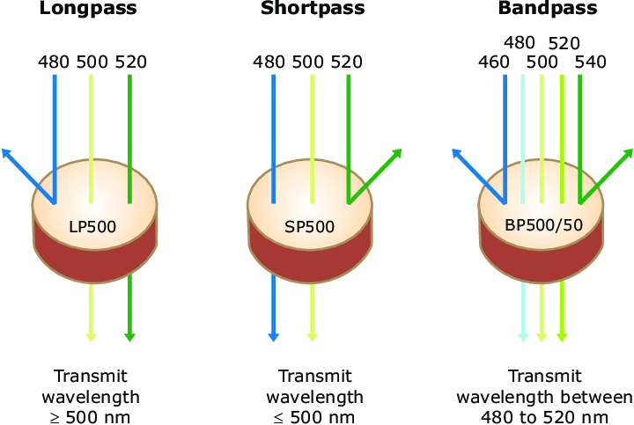
Shortpass, Longpass and Bandpass filters
There are three types of optical filters: shortpass filters, longpass filters, and bandpass filters. A shortpass filter allows shorter wavelengths than the cut-off wavelength to pass through, while it attenuates longer wavelengths. Conversely, a longpass filter transmits longer wavelengths than the cut-on wavelength while it blocks shorter wavelengths. A bandpass filter is a filter that lets a particular range, or “band”, of wavelengths to go through, but attenuates all wavelengths around the band. A monochromatic filter is an extreme case of a bandpass filter, which transmits only a very narrow range of wavelengths.

Slide 7
Shortpass, Longpass and Bandpass filters
There are three types of optical filters: shortpass filters, longpass filters, and bandpass filters. A shortpass filter allows shorter wavelengths than the cut-off wavelength to pass through, while it attenuates longer wavelengths. Conversely, a longpass filter transmits longer wavelengths than the cut-on wavelength while it blocks shorter wavelengths. A bandpass filter is a filter that lets a particular range, or “band”, of wavelengths to go through, but attenuates all wavelengths around the band. A monochromatic filter is an extreme case of a bandpass filter, which transmits only a very narrow range of wavelengths.

Slide 8
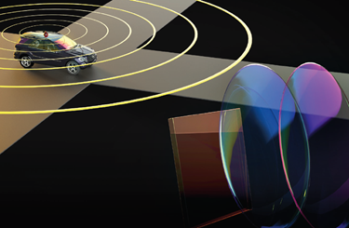
Some Applications of Optical Filters
In systems for laser beam diagnostics with CCD-cameras.
Measurement of laser power, pulse energy and pulse duration.
Spectroscopy.
A set of bandpass filters for mercury lamps, laser lines, and other needs are
available.

Slide 9
Faculty Video Links, Youtube & NPTEL Video Links and Online Courses Details
Video link:
https://www.youtube.com/watch?v=osL2Y-e1eaA
https://www.youtube.com/watch?v=A_3meKTBuWk
https://youtu.be/bIAaQefLZqk
https://www.youtube.com/watch?v=okllowvV4-M

